Slide 1
The Repository Pattern
Organising Data Access

Slide 2
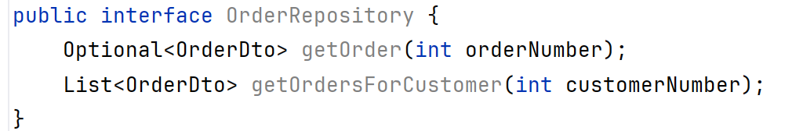
What is a Repository?
  Repository: A component that provides a clear, cohesive interface for accessing and working with application data
    Hides the details of how data is stored and retrieved
    No need to know tables (or DAOs) involved
Application/CLI/GUI:
“Show me order 105”
OrderRepository:
Provides order-related operations; coordinates data access across required DAOs
DAO Layer
Orders - OrderDetails - Products - Customers
Database
JDBC -> MySQL
Notes:
Application asks for data it needs, but doesn’t need to know or care where that data is or how it’s organised.
Repository encapsulates (hides) the details, providing a clear point to request it

Slide 3
Revision: Customers, Orders, OrderDetails and Products
Customers
Products
Orders
OrderDetails
Customer details and contact information.
Product names, prices and availability.
A customer’s order header: date and status.
Products, quantities and prices within an order.
Customer
Order
OrderDetail
Product
One customer can place many orders; each order contains order lines, and each line refers to a product.

Slide 4
Why Do We Need Repositories?
Without a Repository… | With a Repository!
The CLI (front end) needs to know which DAO(s) to call | The CLI (front end) asks for a specific result or action to be carried out
A single use-case can spread across several calls | The repository coordinates the relevant DAOs
Business decisions can leak into the front end | Use-case logic is not part of data access, it’s built on top of it
Changing how we store data can ripple up the layers all the way to the interface | Use-case logic is not part of the front end, it’s in a layer below it
  The repository pattern is an organising layer
    It doesn’t replace daos or SQL
    It helps use them

Slide 5
Where Do Repositories Fit?
CLI / Front End
Collect input • display results
Dependency direction
↓
Higher layers call lower layers through clear interfaces.
Repository
Application use cases • coordinates DAOs
↓
DAO layer
Table-oriented database operations
Important boundary
The CLI must not execute SQL or call DAOs directly.
↓
JDBC + MySQL
SQL execution • rows • transactions

Slide 6
DAO vs Repository: Different Roles, Different Responsibilities
DAO — data access
Repository — application use case
Examples:
• ProductDao. getProductByProductCode(productCode)
• OrderDetailDao. getOrderDetailsByOrderNumber(orderNumber)
• Map ResultSet rows to entity objects
• Execute parameterised SQL
Focus: persistence operations.
Examples:
• getOrder(orderNumber)
• getOrdersForCustomer(customerNumber)
• Coordinate CustomerDao, OrderDao, OrderDetailDao and ProductDao
• Return a useful result to the CLI (this is often using custom DTOs built for that use-case)
Focus: application-facing (logic) operations.
A Repository may call one DAO or it may call several. It should never become an SQL layer itself.

Slide 7
Use-Case:
Get Order (Including Order Details)
OrderDao
The CLI asks:
getOrderByOrderNumber
CLI
Repository
OrderLineDao
“Show order 10100, including the customer name, products, quantities and prices.”
orderNumber = 10100
getOrder
getOrderDetailsByOrderNumber
ProductDao
getProductByProductCode
CustomerDao
getCustomerByCustomerNumber
Repository’s responsibility
Coordinate retrieval, assemble a useful order-details result, and define behaviour if the order does not exist. The CLI should never need to know which DAOs are involved.
Use cases are the organising principle – tables are just the boxes we get the data from

Slide 8
Design the Repository API First!
  Use names from customer/order tasks.
    Method names should indicate what you’re trying to do, not what tables are involved
  Accept IDs, simple parameters or complex objects
    Let the parameters suit the action being requested
  Return custom DTOs where necessary/useful
    Don’t tie yourself to entities – you can build objects that suit this particular request
  Do not expose SQL-related classes
    This includes Connection, PreparedStatement and ResultSet!
Remember: An interface is a contract saying what the repository can do

Slide 9
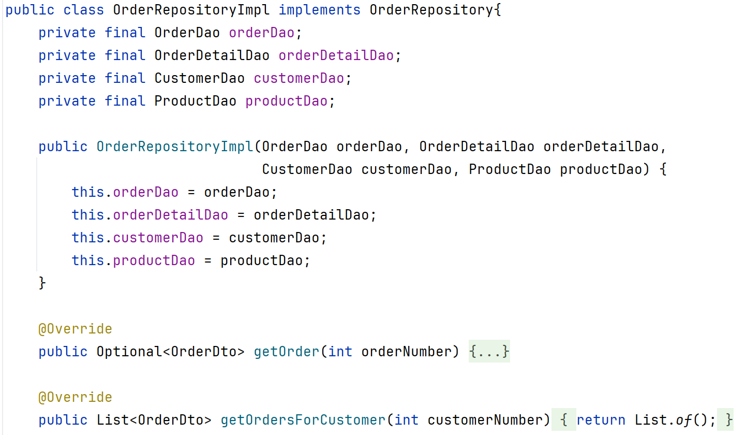
Repository Implementation Using DAOs Via Their Interfaces
Constructor injection
Dependencies are supplied from outside.
No SQL here
The repository leaves all database work (i.e. delegates it) to DAOs.
Design note
Empty list is a possibility; don’t forget!
Full code: week05_repositories/repositories/OrderRepositoryImpl.java

Slide 10
Common Mistakes to Avoid
Repository that just renames a DAO
If it doesn’t add any use-case value, reconsider if the layer is needed
SQL inside a repository
All SQL and database mechanics belong in in the DAO layer only
CLI/Front end calling database/DAOs directly
The UI should always go through the repository API!
One giant “ApplicationRepository” that handles everything
Split your repositories based on logical areas/use-cases
Business logic within DAOs
DAOs are about persistence, not logic. They perform CRUD, they don’t think.

Slide 11
Testing: Confirming Your Boundaries Hold
DAO integration tests
Repository Tests
CLI/Front-End Checks
Use a test database to verify SQL, constraints, row mapping and persistence behaviour.
Verify use-case combined results and handling of missing or invalid data.
Verify prompts and output; keep database logic out of the UI!
Something to ask yourself:
If one of your DAO implementations changes but its interface stays stable,
should the CLI need to change?

Slide 12
Final Takeaways – Remember These!
  DAO: Database actions and row mapping
  Repository: Application-facing use-cases and orchestration
    Orchestration: Coordinating the steps involved across different DAOs, along with combining their results, to facilitate a use-case
  CLI should never interact with the DAO layer directly
    Repository is the middle-man between CLI and DAO
  Use constructor injection (form of dependency injection) to ensure dependencies are explicit and customisable
  JDBC should only appear in the DAO layer
Remember this workflow:
CLI → Repository → DAO → JDBC → MySQL

